Slide 1
Connect Secure w. Okta (SAML 2.0)
SAML 2.0 Setup and Configuration

Slide 2
Overview
These instructions will show you how to configure Pulse Connect Secure (Service Provider) with Okta (Identity Provider).
Do not select the Juniper application within Okta. It only supports SAML 1.1

Slide 3
SAML Process
Pulse Connect Secure (Service Provider)
Okta (Identity Provider)
Browser
http://vpn.ps.kh-tech.net/okta
https://dev-342677.oktapreview.com/app/pulsesecurellcdev342677_pulseconnectsecure_2/exk6jdyer64ZIXuX50h7/sso/saml
https://vpn.ps.kh-tech.net/dana-na/auth/saml-consumer.cgi

Slide 4
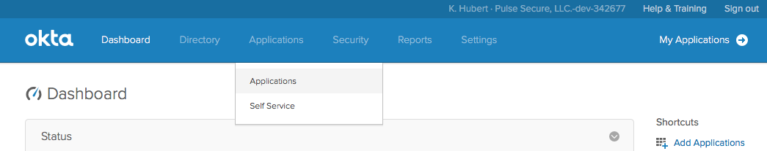
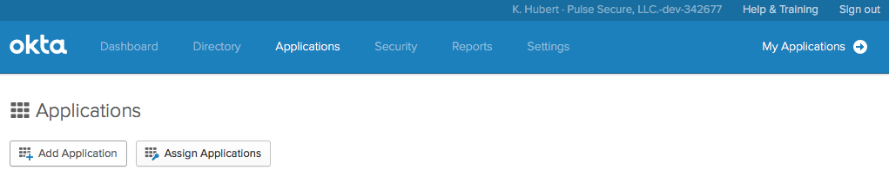
Okta – Create New Application

Slide 5
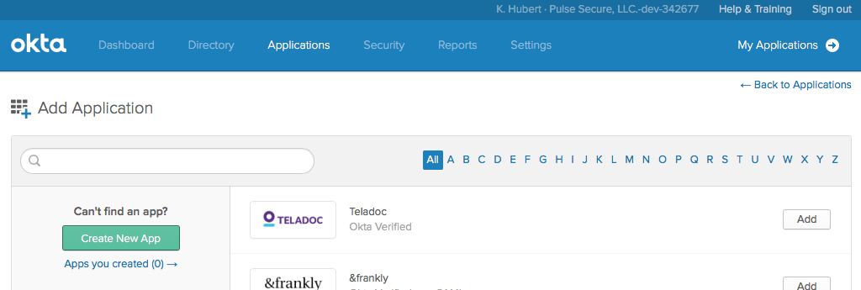
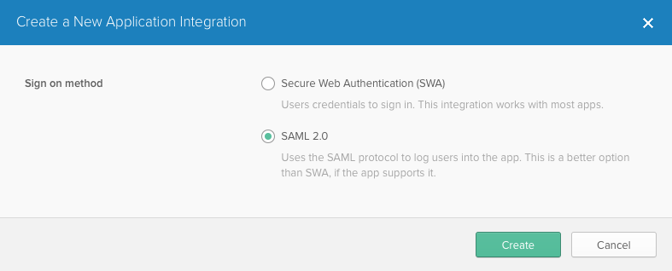
Okta – Create New Application

Slide 6
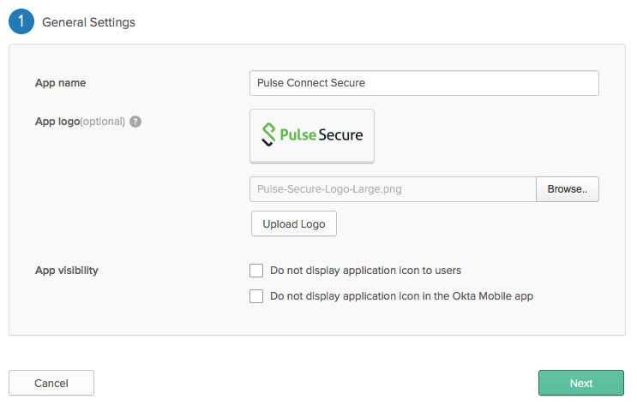
Okta – Create New Application

Slide 7
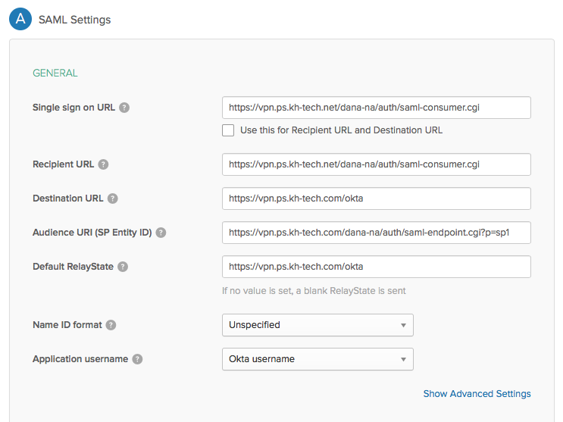
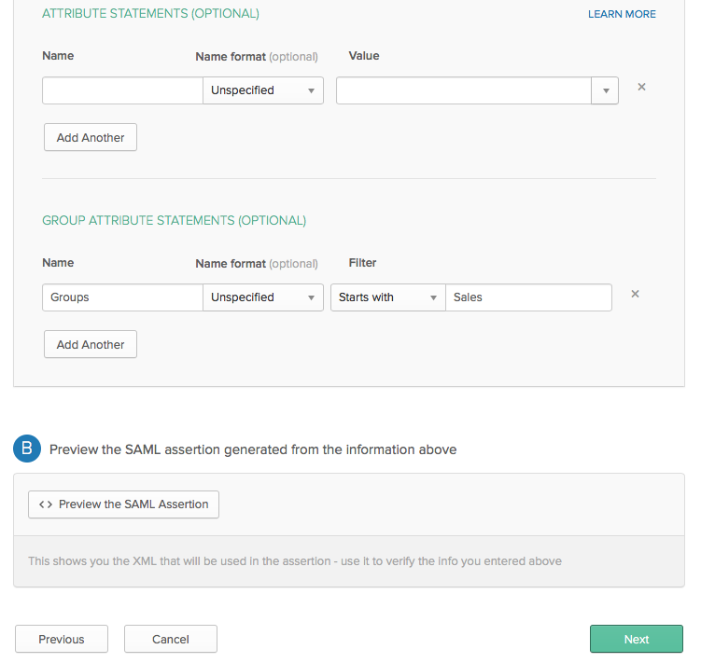
Okta – Define Connect Secure URLs
uncheck
Specify the Groups you want sent to ConSec.
Enter
This URL changes for every SAML Auth. Server in PCS. If more than one, you’ll need to come back to Okta to change it accordingly. See Slide 17
Copy/Paste
https://HOSTNAME/dana-na/auth/saml-consumer.cgi
https://HOSTNAME/okta ← This is the Connect Secure Sign-in URL
https://HOSTNAME/dana-na/auth/saml-endpoint.cgi?p=sp1

Slide 8
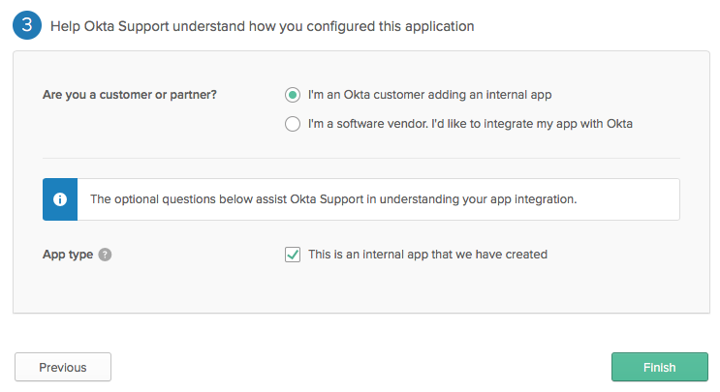
Okta – Extra Information

Slide 9
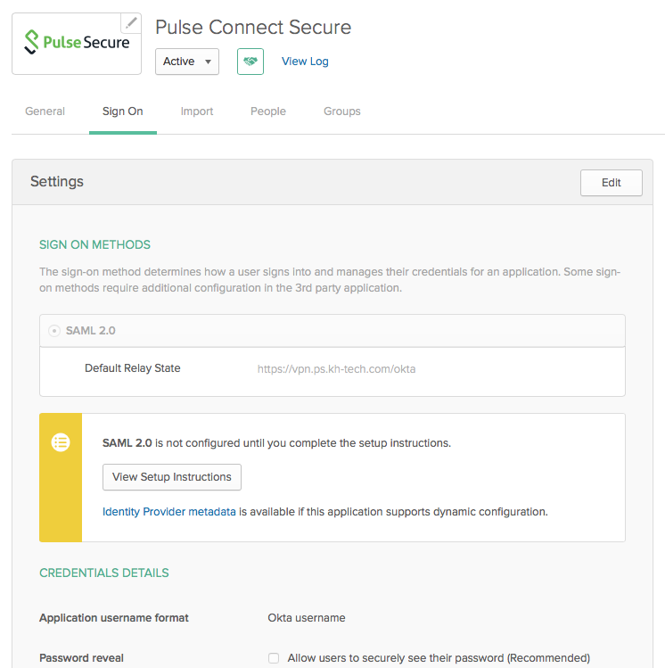
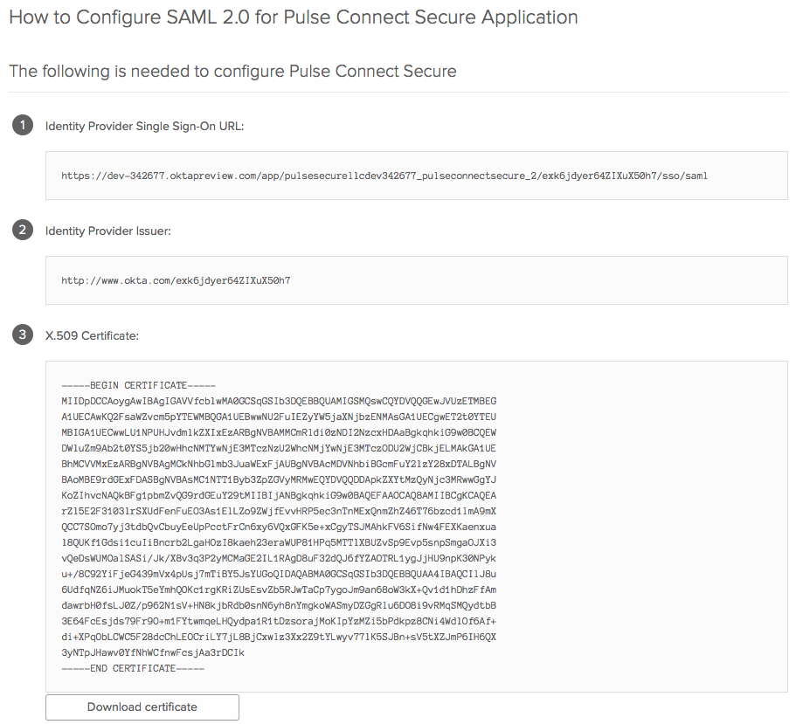
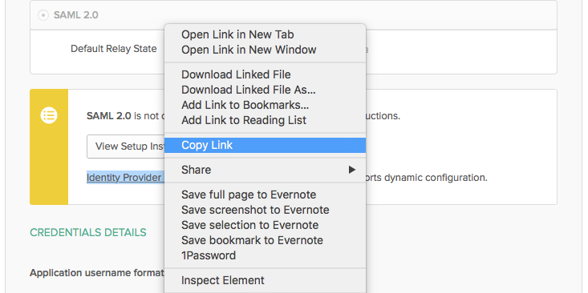
Okta – Get Certificate & Metadata
Opens in new tab
Save for Later (Slide 15)

Slide 10
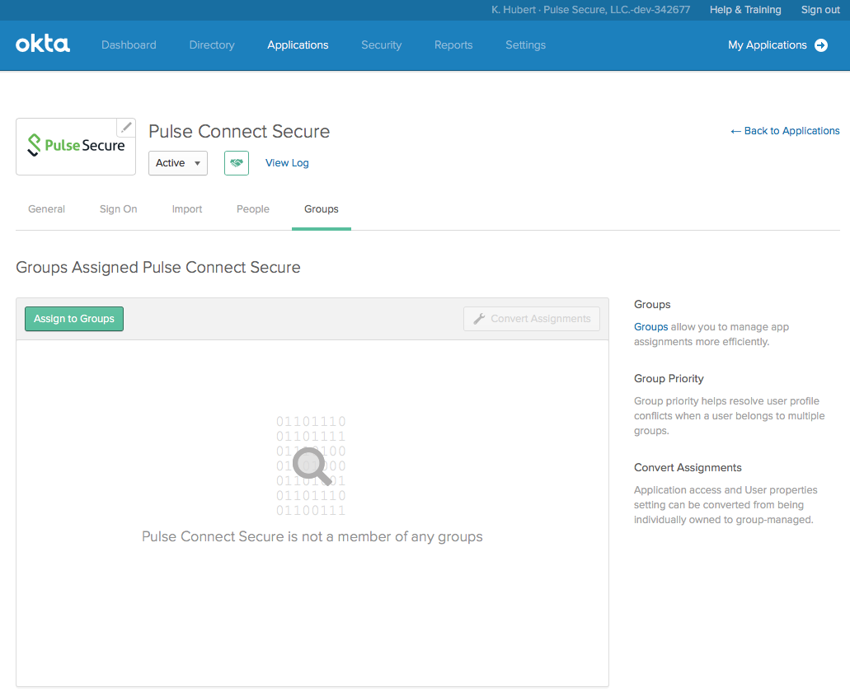
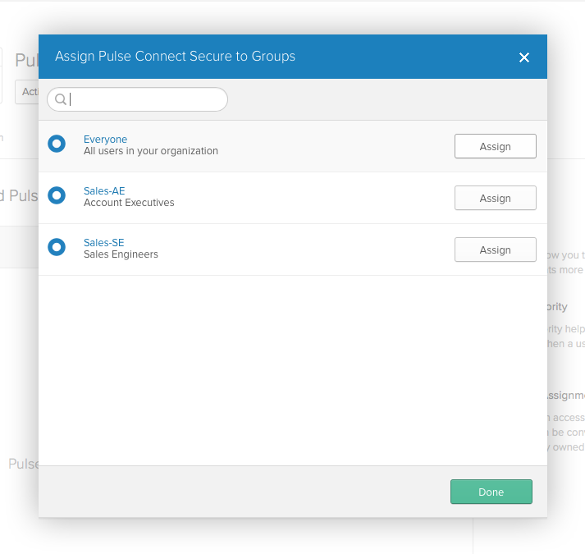
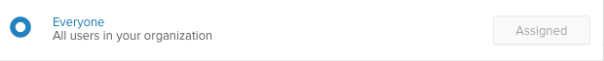
Okta – Assign Application to Group

Slide 11
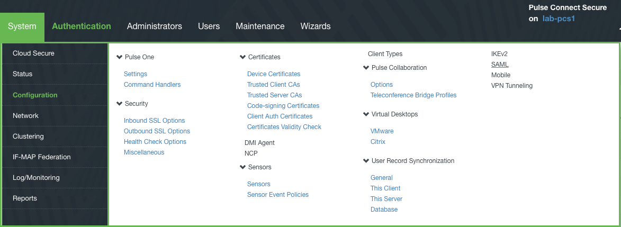
Connect Secure – Set Up SAML

Slide 12
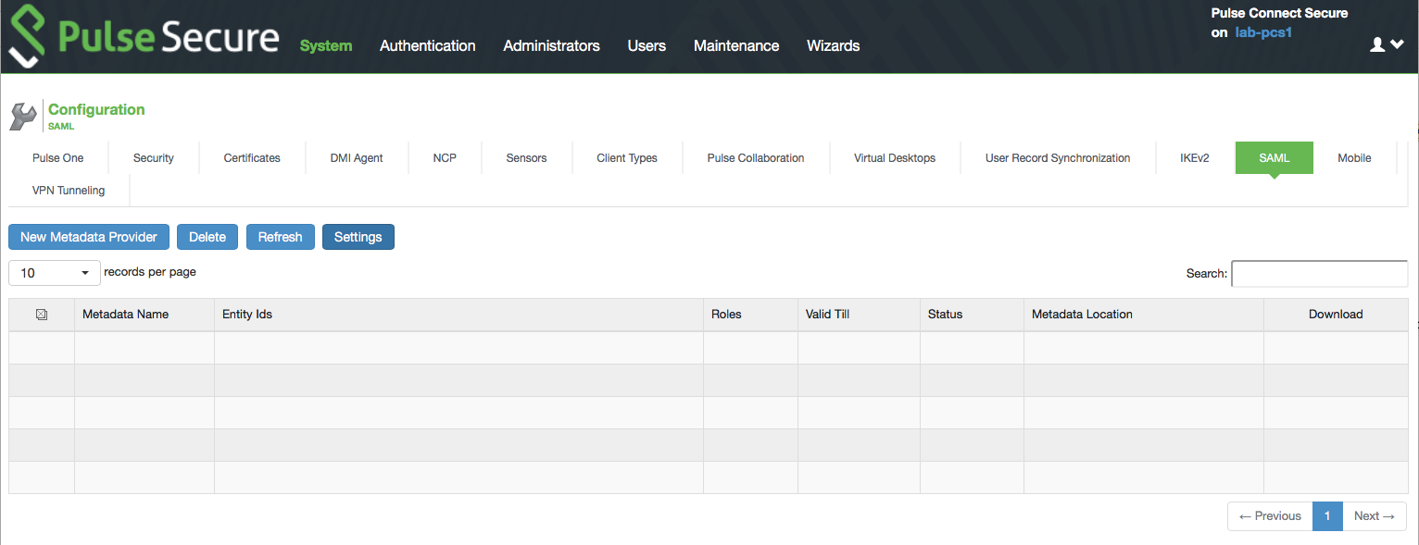
Connect Secure – Set Up SAML

Slide 13
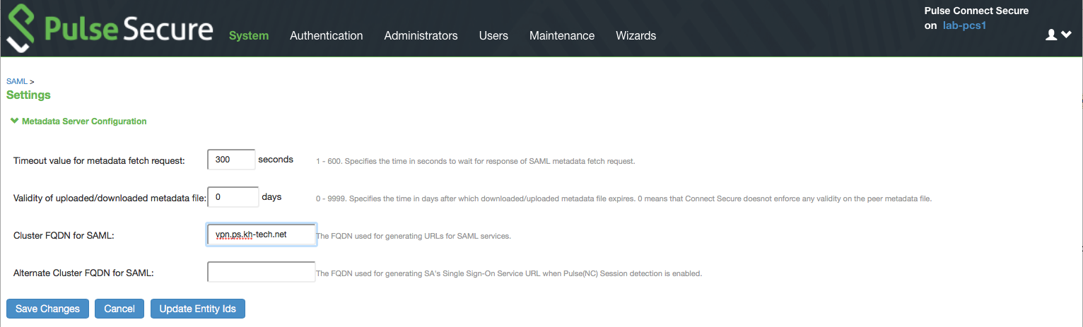
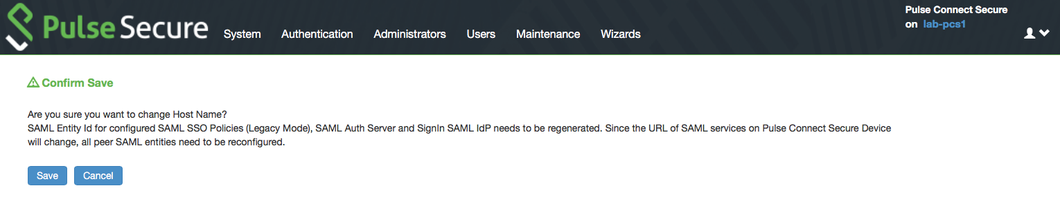
Connect Secure – Set Up SAML

Slide 14
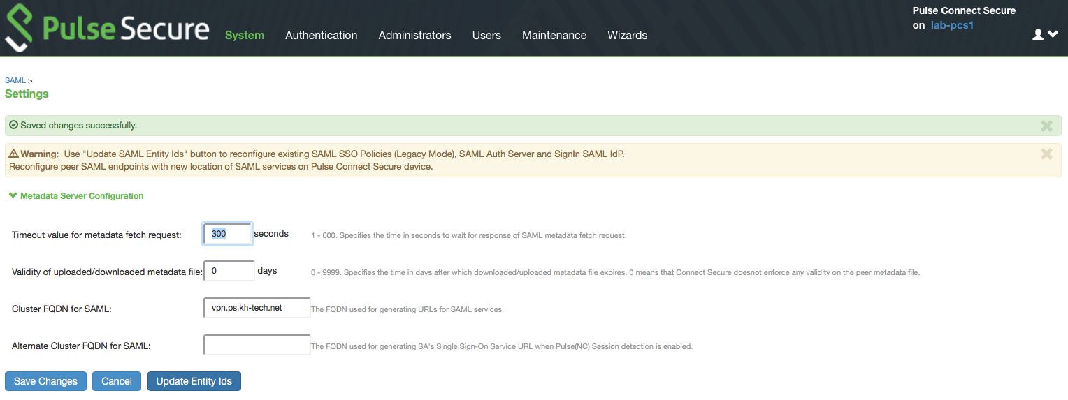
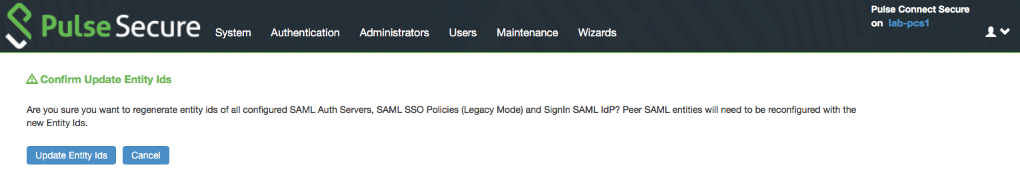
Connect Secure – Set Up SAML

Slide 15
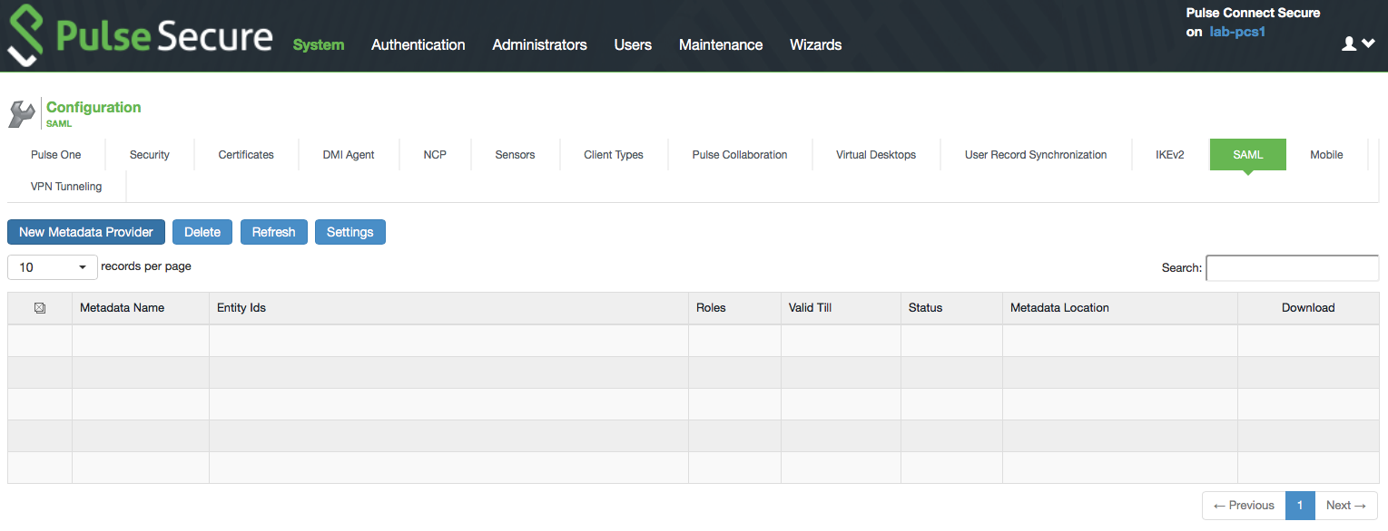
Connect Secure – Metadata Provider

Slide 16
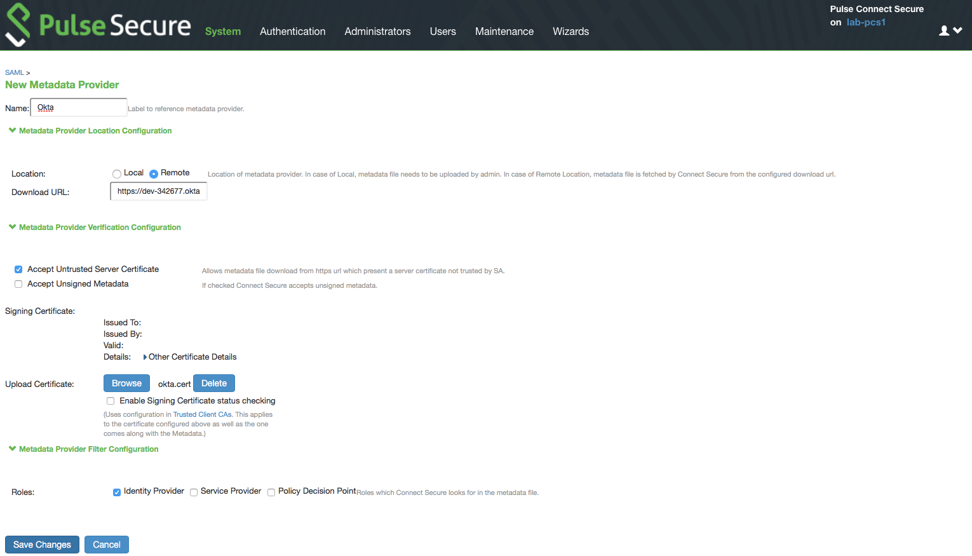
Connect Secure – Metadata Provider
Identity Provider metadata (Link copied earlier)

Slide 17
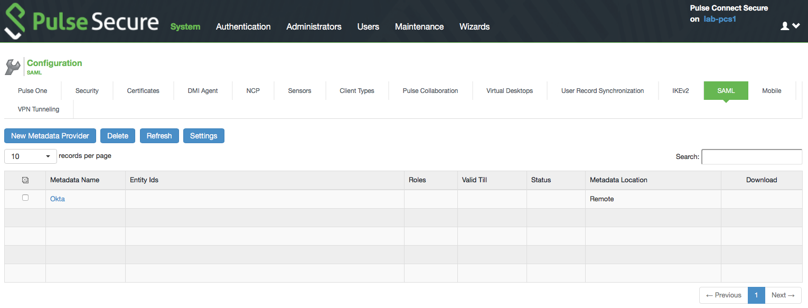
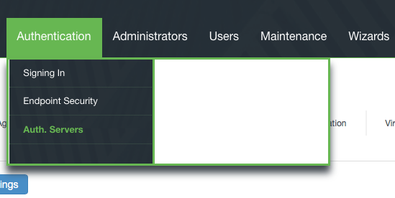
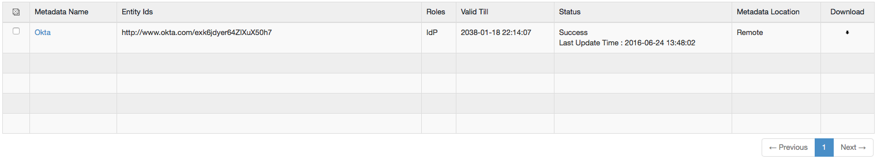
Connect Secure – Auth. Server
Click to Refresh

Slide 18
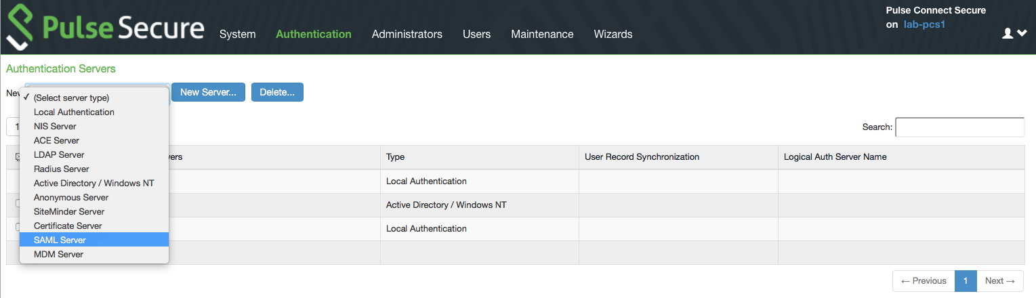
Connect Secure – Auth. Server

Slide 19
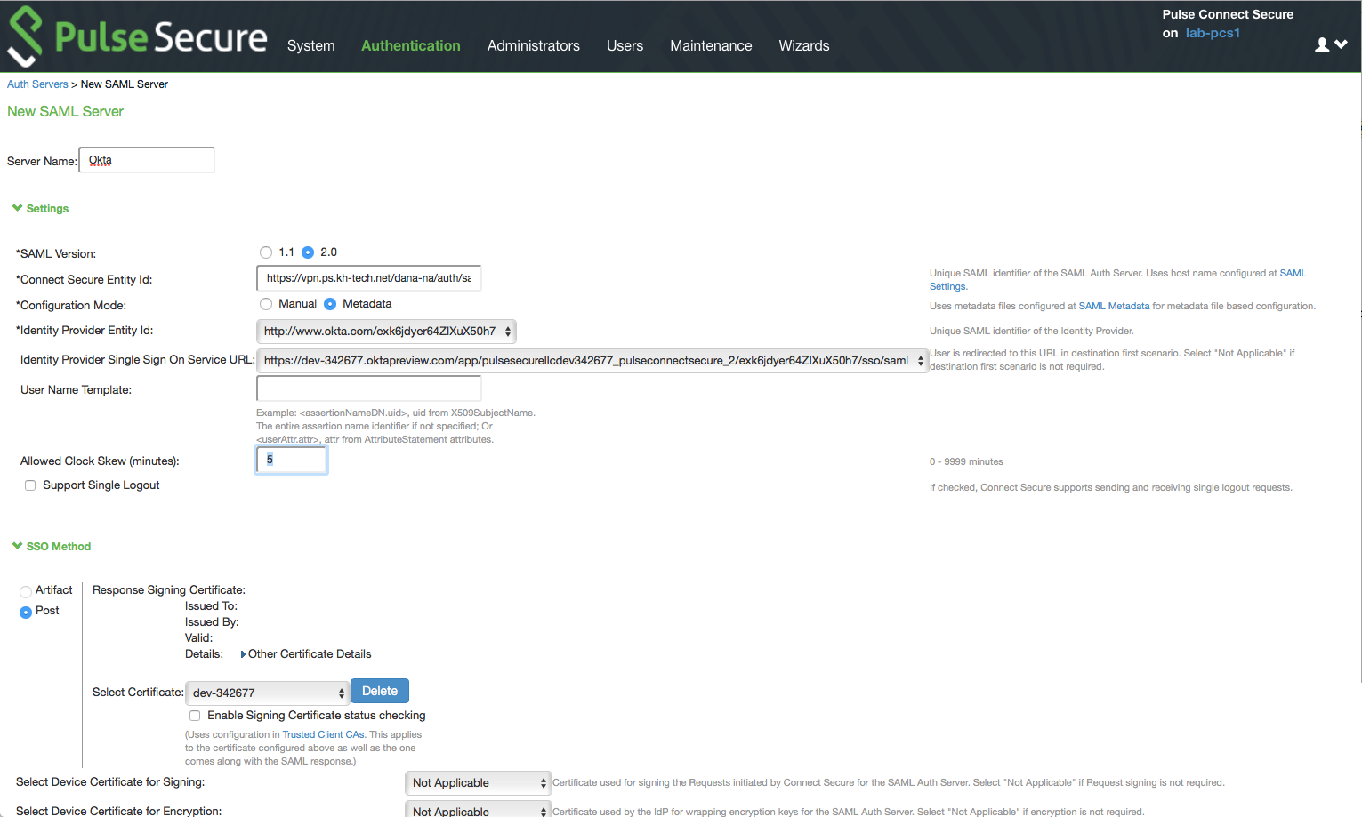
Connect Secure – Auth. Server
This URL changes for every SAML Auth. Server. If more than one, you’ll need to change it in Okta.
Select
Select

Slide 20
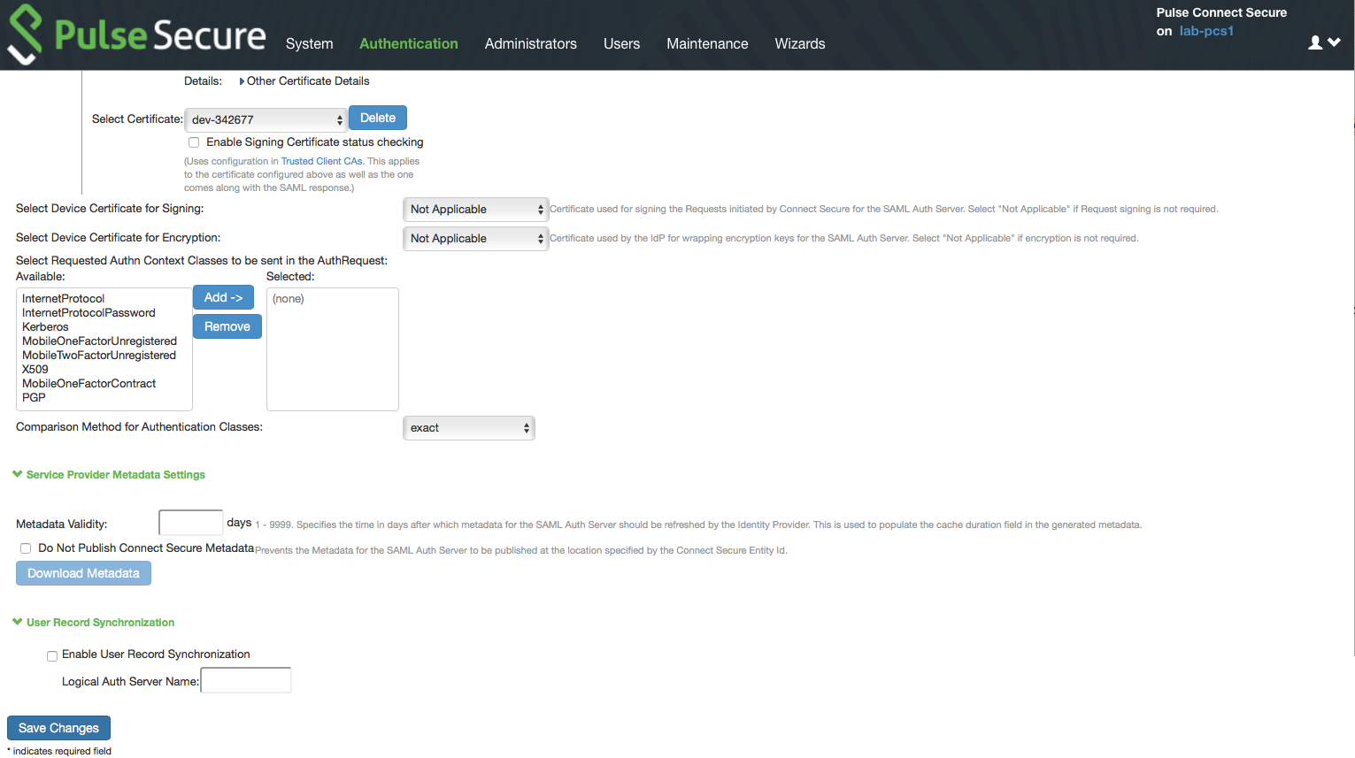
Connect Secure – Auth. Server

Slide 21
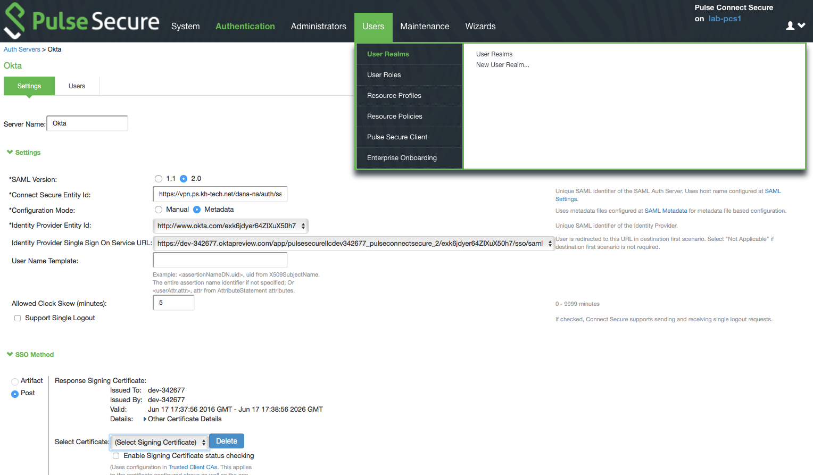
Connect Secure – User Realm

Slide 22
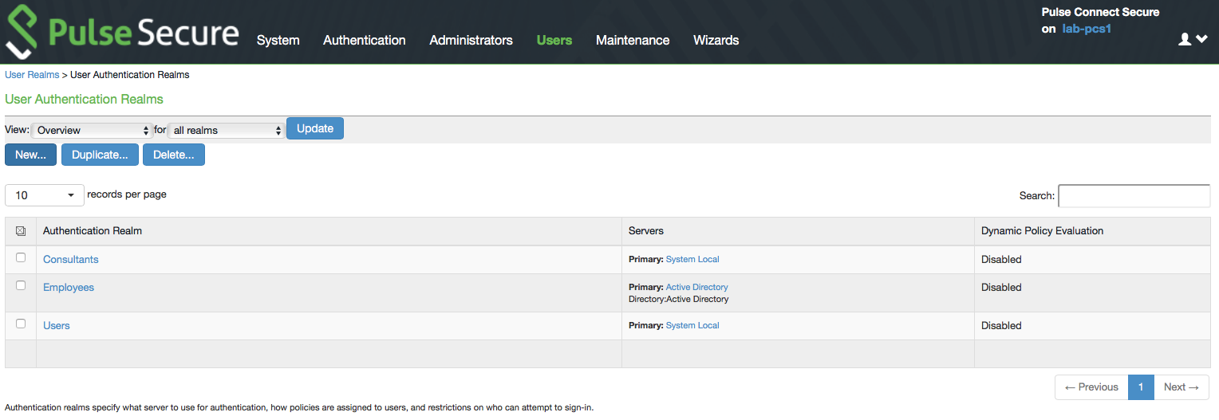
Connect Secure – User Realm

Slide 23
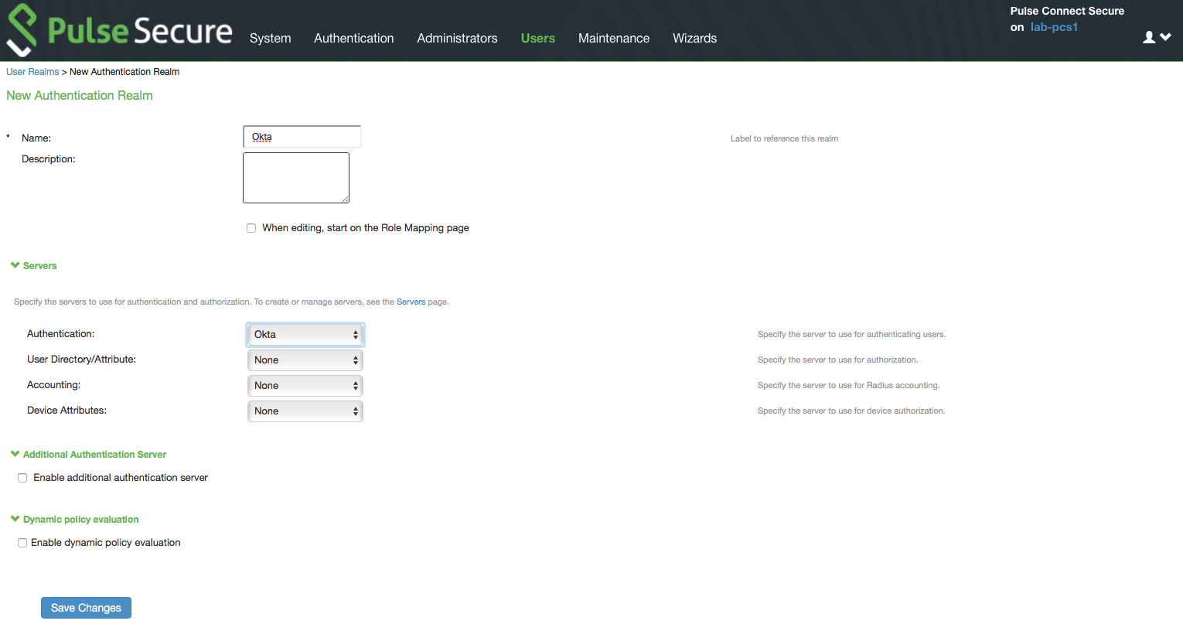
Connect Secure – User Realm

Slide 24
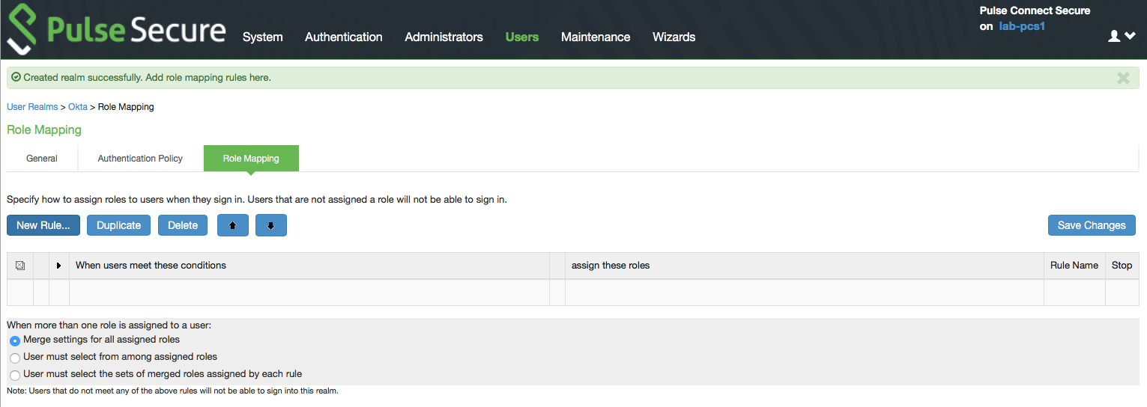
Connect Secure – Role Mapping

Slide 25
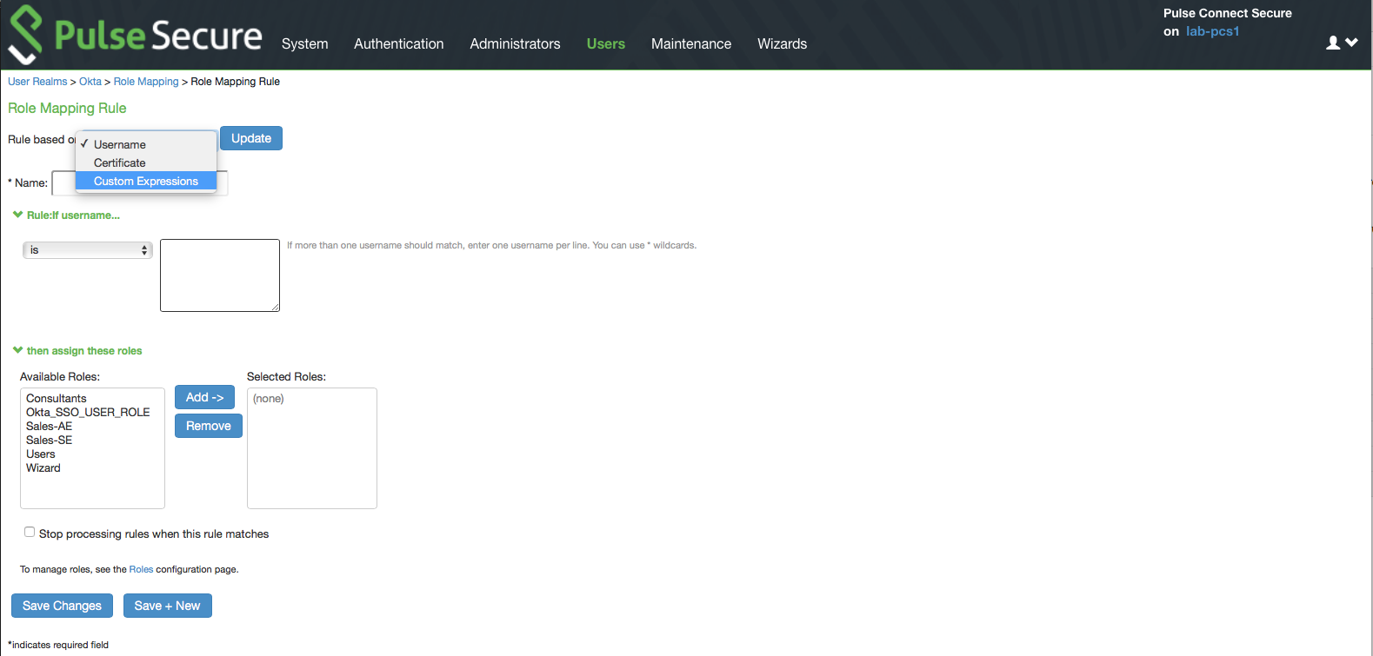
Connect Secure – Role Mapping

Slide 26
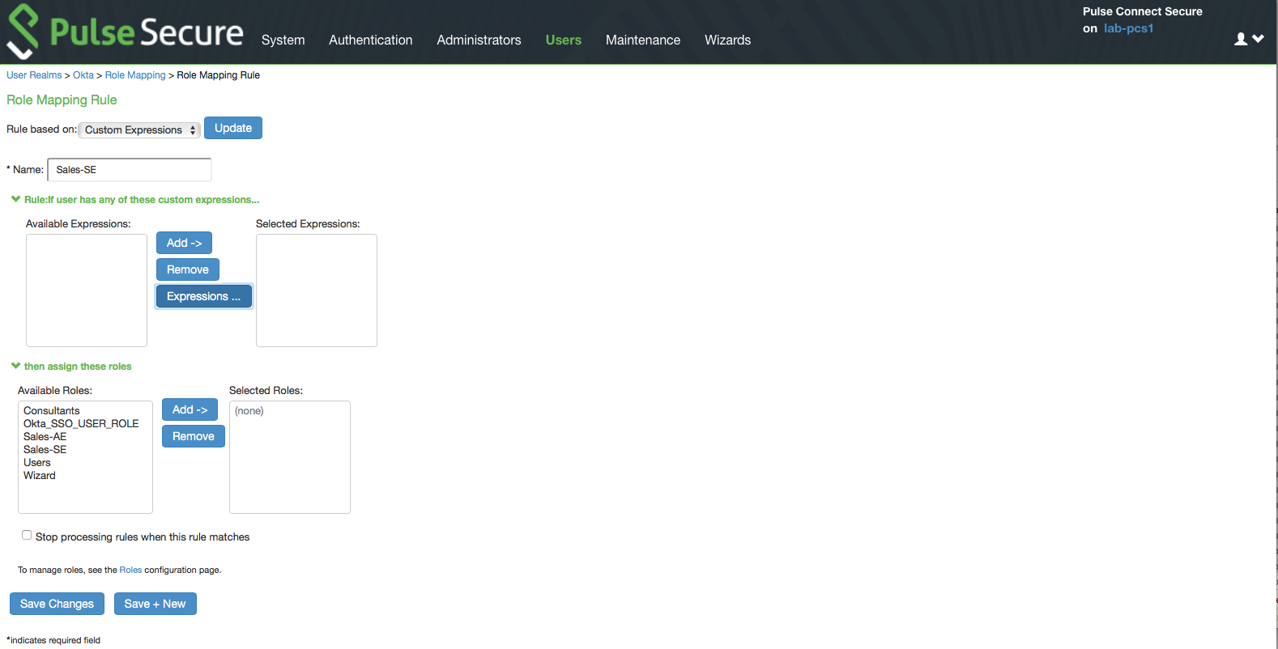
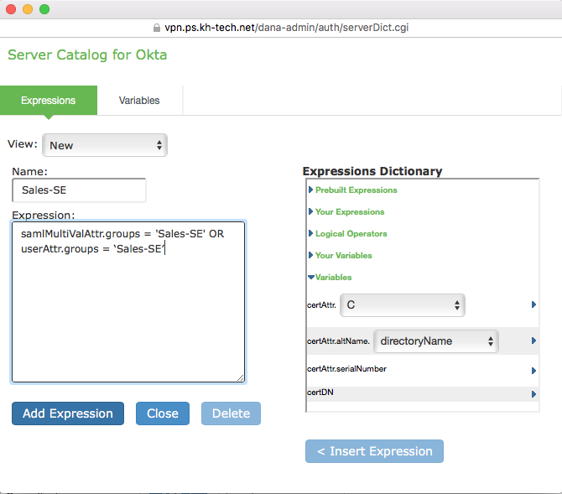
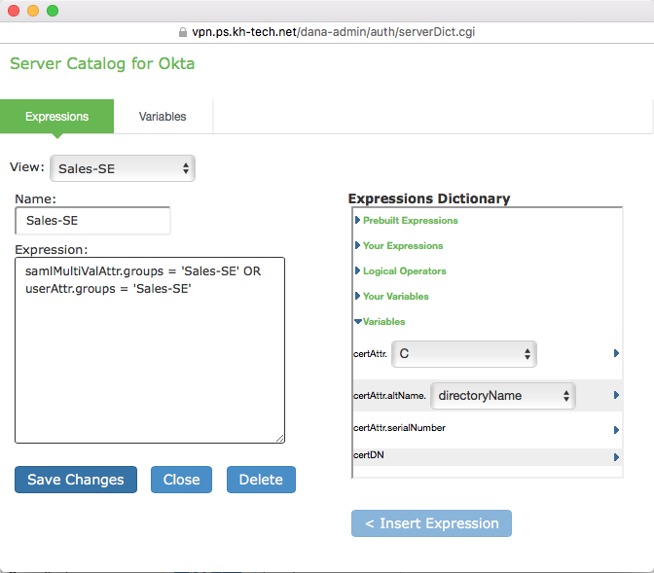
Connect Secure – Role Mapping
samlMultiValAttr.groups if the users are in more than 1 group.
userAttr.groups if the users are in single group.

Slide 27
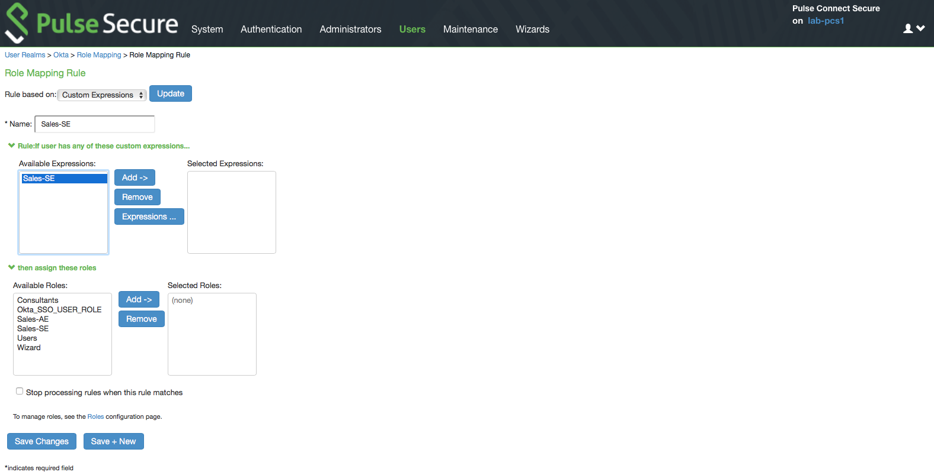
Connect Secure – Role Mapping

Slide 28
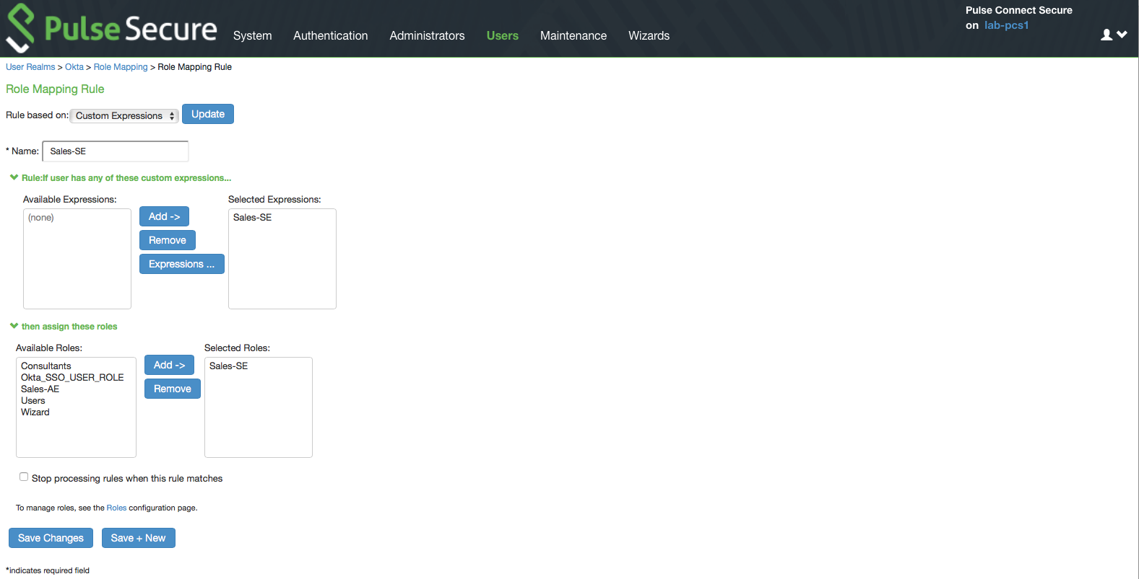
Connect Secure – Role Mapping

Slide 29
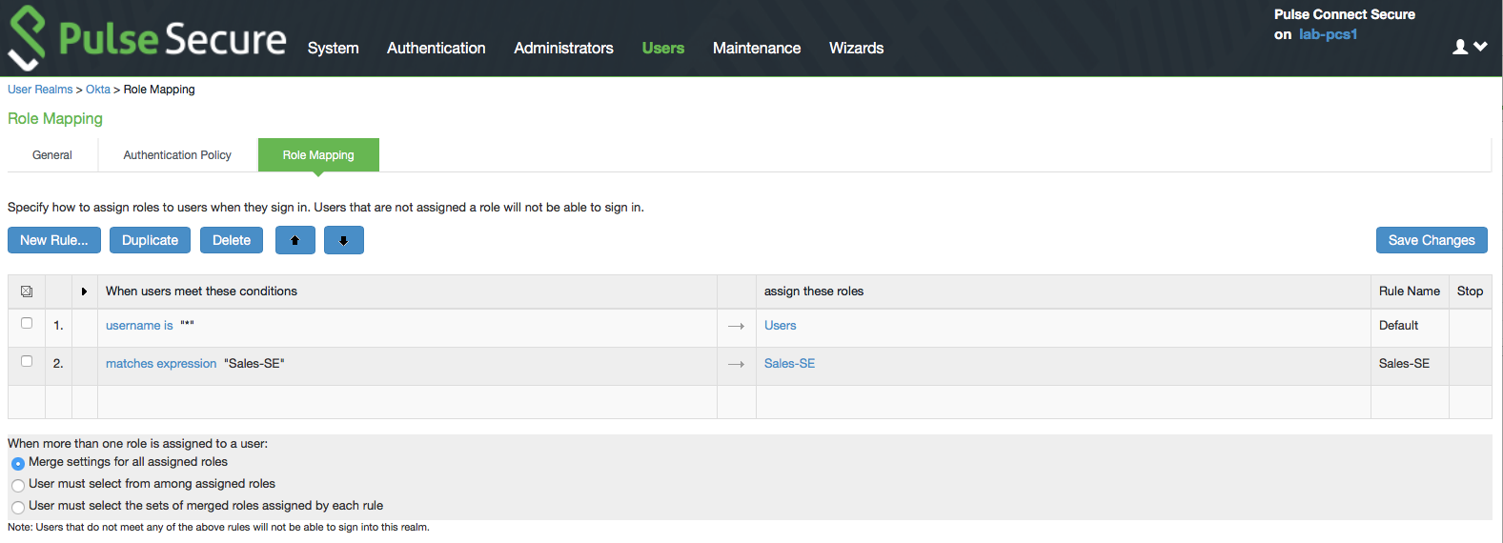
Connect Secure – Role Mapping

Slide 30
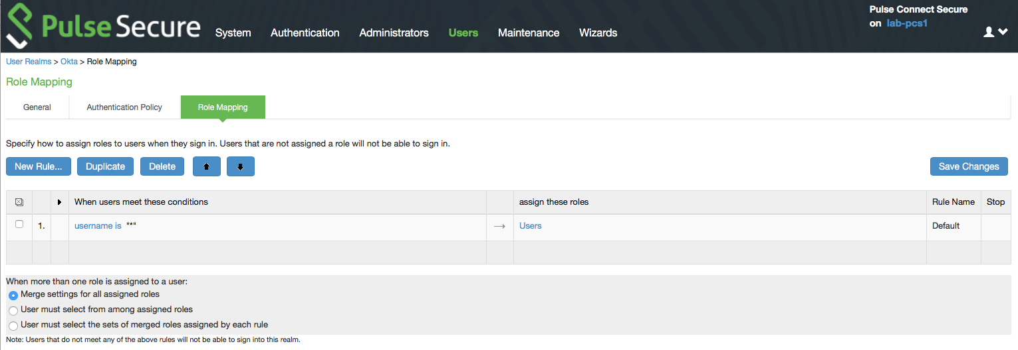
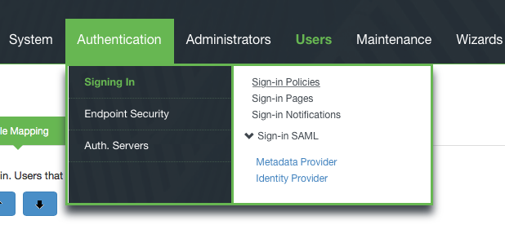
Connect Secure – Sign-in Policy

Slide 31
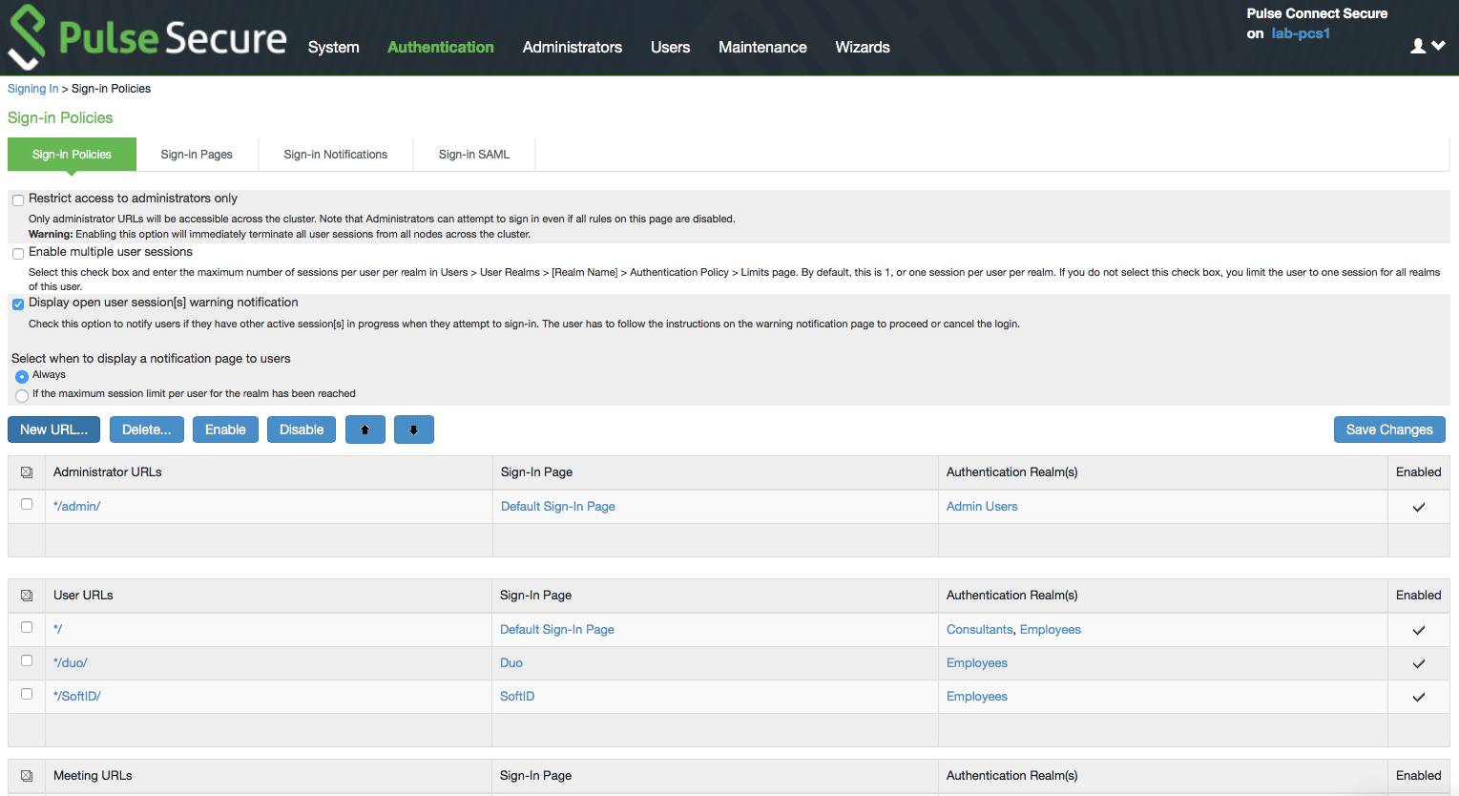
Connect Secure – Sign-in Policy

Slide 32
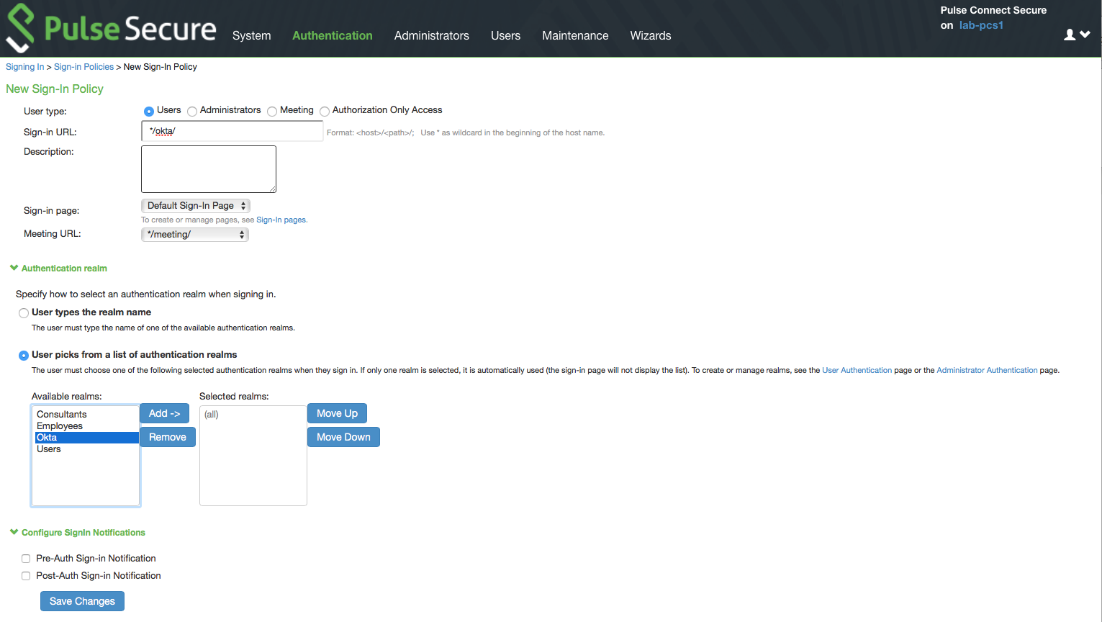
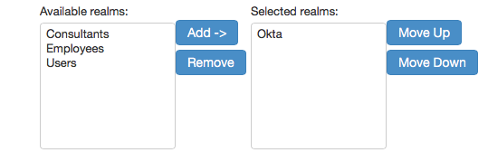
Connect Secure – Sign-in Policy

Slide 33
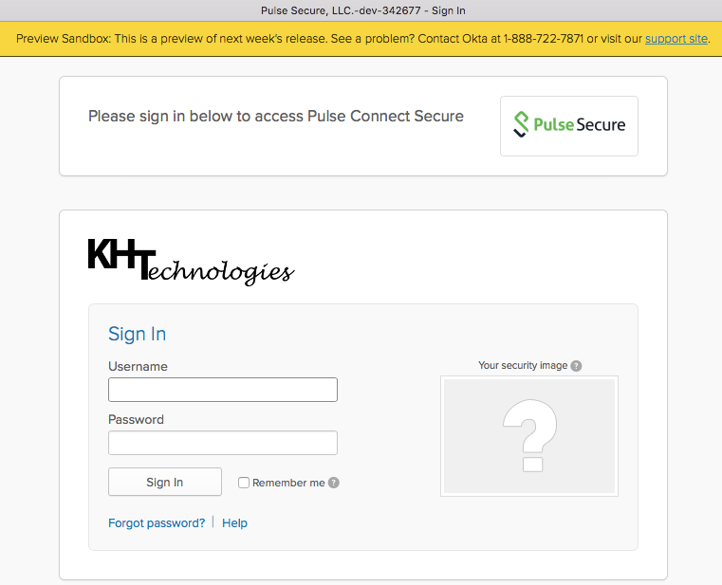
http://vpn.ps.kh-tech.net/okta

Slide 34
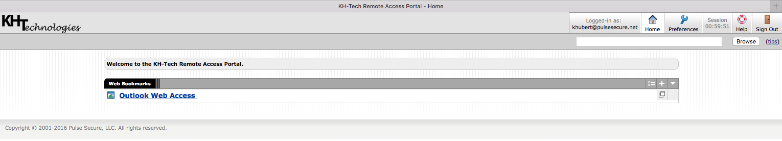
http://vpn.ps.kh-tech.net/okta

